Slide 1

Prediction of the FIFA Player’s Wage

Slide 2






Team Member
Rohan Choudhary
Xiaoge Zhang
Yezhi Miao
Peichun Tseng
Mingyu Liu
Mibin Zhu

Slide 3



Contents
1
Data Preparation
2
Linear Regression
Team 7
3
Logistic Regression
4
Step-wise Regression
5
Model Improvement

Slide 4




Data Preparation
Linear Regression
Introduction
Logistic Regression
Step-wise Regression
Model Improvement

Slide 5
Define Appropriately the Problem ?
Data Preparation
Linear Regression
•The first, and one of the most critical things What is the main objective? What are we trying to predict?
•What are the target features?
•What is the input data? Is it available?
•What kind of problem are we facing? Binary classification? Clustering?
•What is the expected improvement?
•What is the current status of the target feature?
•How is going to be measured the target feature?
Logistic Regression
Step-wise Regression
Model Improvement

Slide 6
How Data is collected ?
Data Preparation
Linear Regression
Web Scraping
Web scraping is about downloading structured data from the web, selecting some of that data, and passing along what you selected to another process.
Logistic Regression
Step-wise Regression
Model Improvement

Slide 7
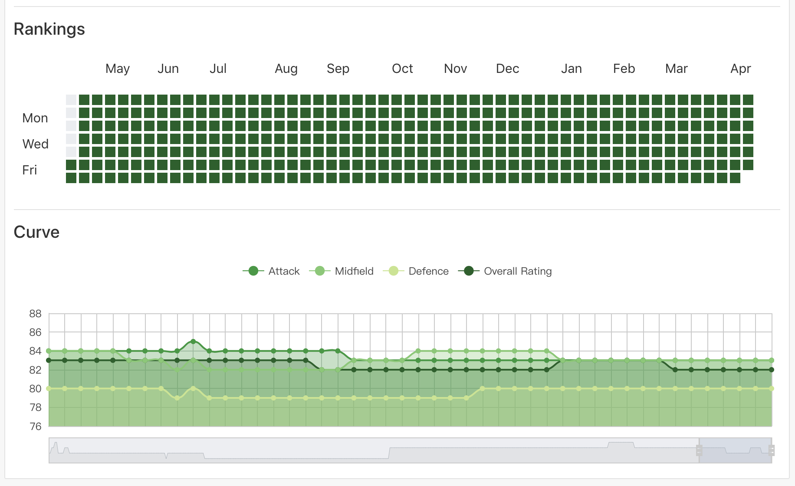
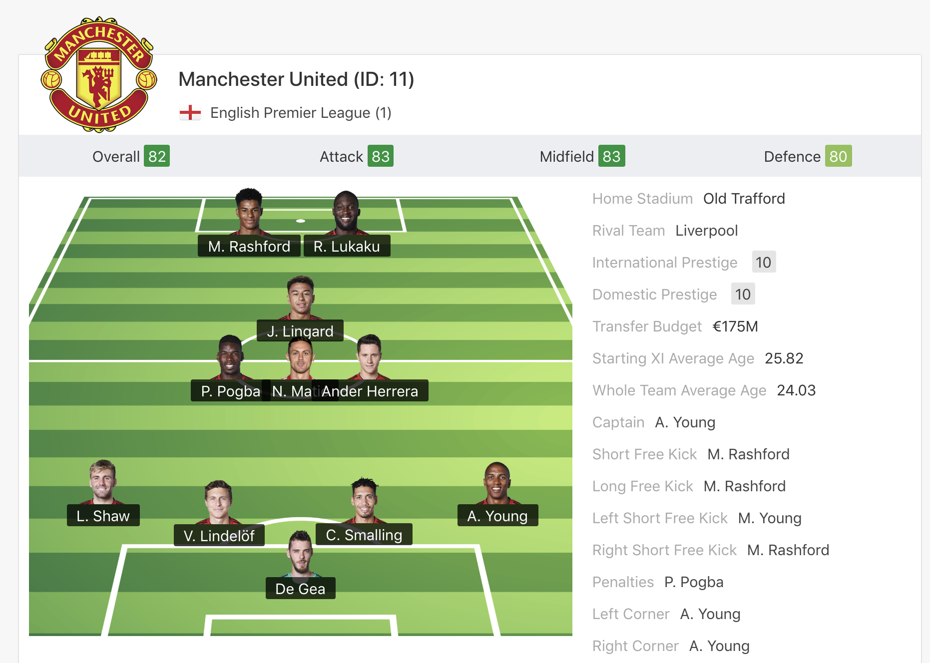
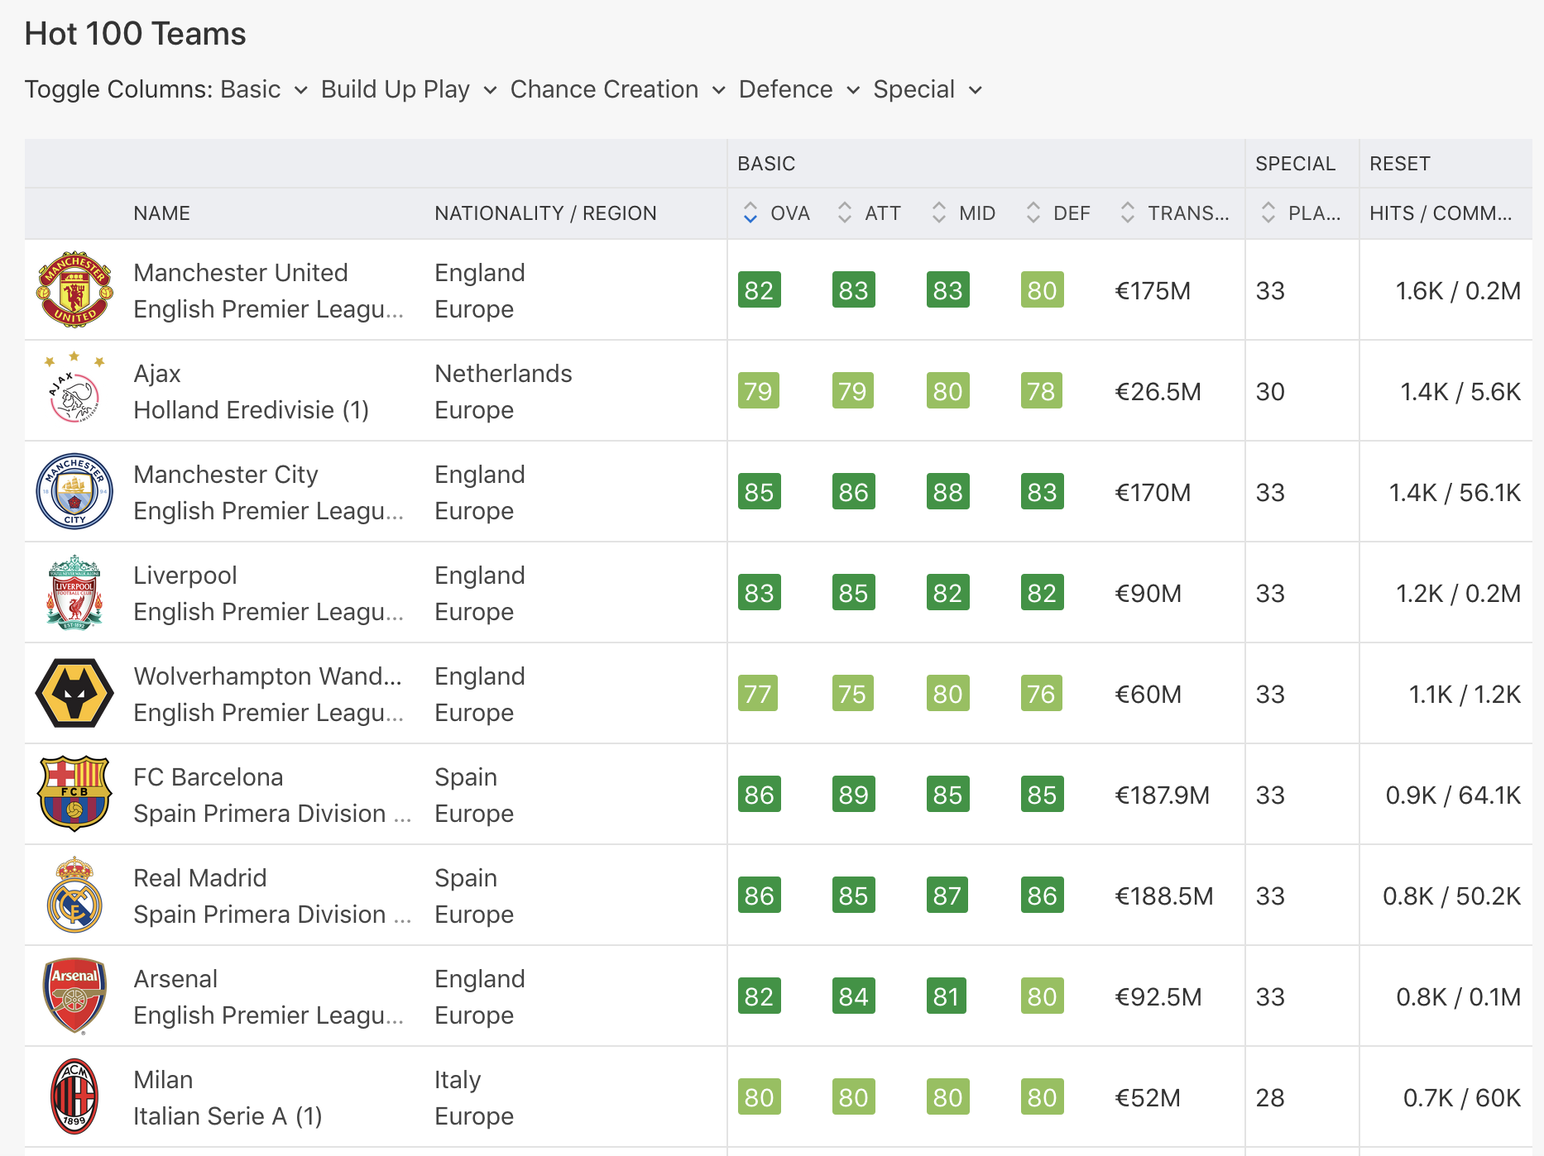
Data Preparation
Linear Regression
Logistic Regression
Step-wise Regression
Model Improvement
Here is the website we got our dataset

Slide 8
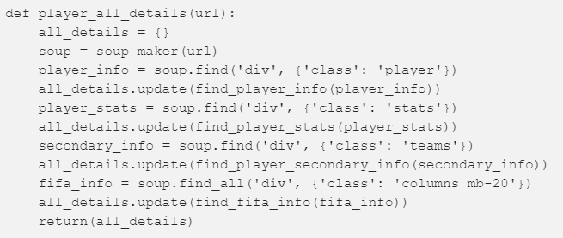
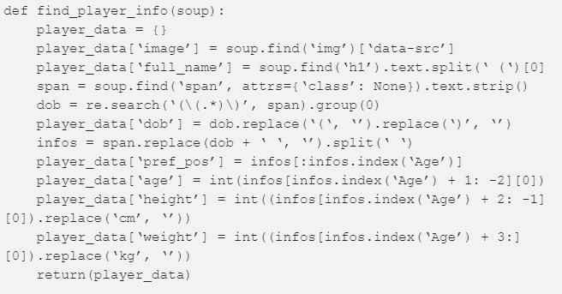
How Data is collected ?
Data Preparation
Linear Regression
Logistic Regression
Step-wise Regression
Model Improvement

Slide 9
What is data cleaning?
Data Preparation
Linear Regression
Data cleansing or data cleaning is the process of detecting and correcting (or removing) corrupt or inaccurate records from a record set, table, or database and refers to identifying incomplete, incorrect, inaccurate or irrelevant parts of the data & then replacing, modifying, or deleting the coarse data.
Logistic Regression
Step-wise Regression
Model Improvement

Slide 10
Data Preparation
Steps for data cleaning
Linear Regression
•Dropping irrelevant columns : Examples – ID, Photo, Nationality, Flag, Jersey Number
•Identifying the correct Target variable – In our case example : Wages
•Find out the zero values and replace with median
Logistic Regression
Step-wise Regression
Model Improvement

Slide 11
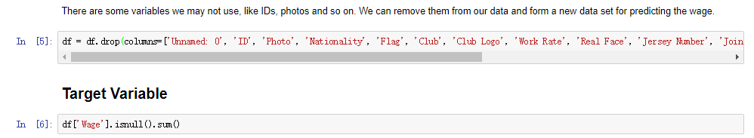
Code Snippets for Data Cleaning
Data Preparation
Linear Regression
Logistic Regression
Step-wise Regression
Model Improvement

Slide 12
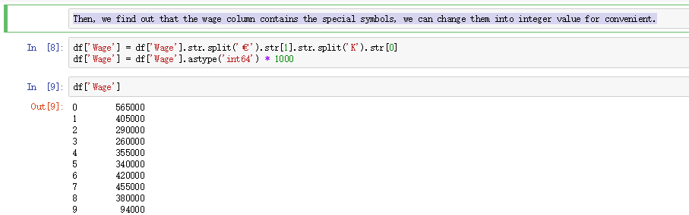
Code Snippets for Data Cleaning
Data Preparation
Linear Regression
Logistic Regression
Step-wise Regression
Model Improvement

Slide 13
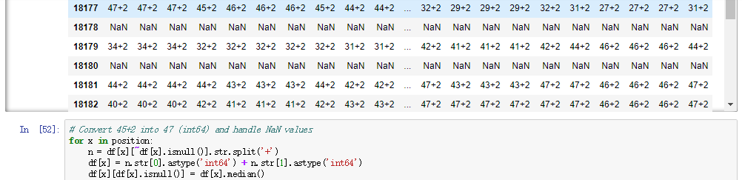
Code Snippets for Data Cleaning : Input
Data Preparation
Linear Regression
yyyyy
Logistic Regression
Step-wise Regression
Model Improvement

Slide 14
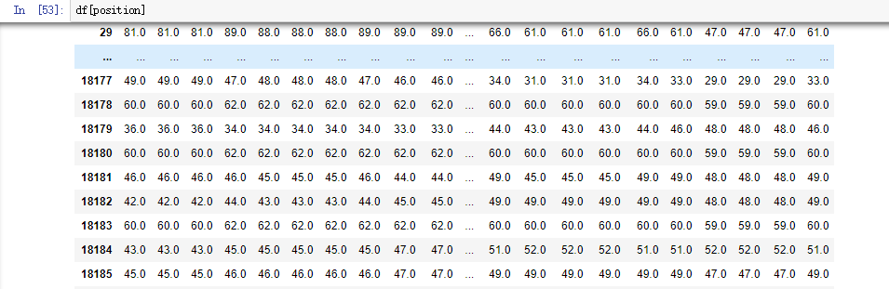
Code Snippets for Data Cleaning : Output
Data Preparation
Linear Regression
Logistic Regression
Step-wise Regression
Model Improvement

Slide 15
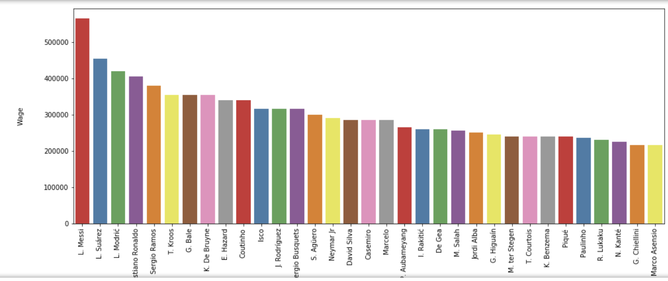
Transformation & Data Cleaning
Data Preparation
Linear Regression
Sorting the wages:
Logistic Regression
Step-wise Regression
Model Improvement

Slide 16
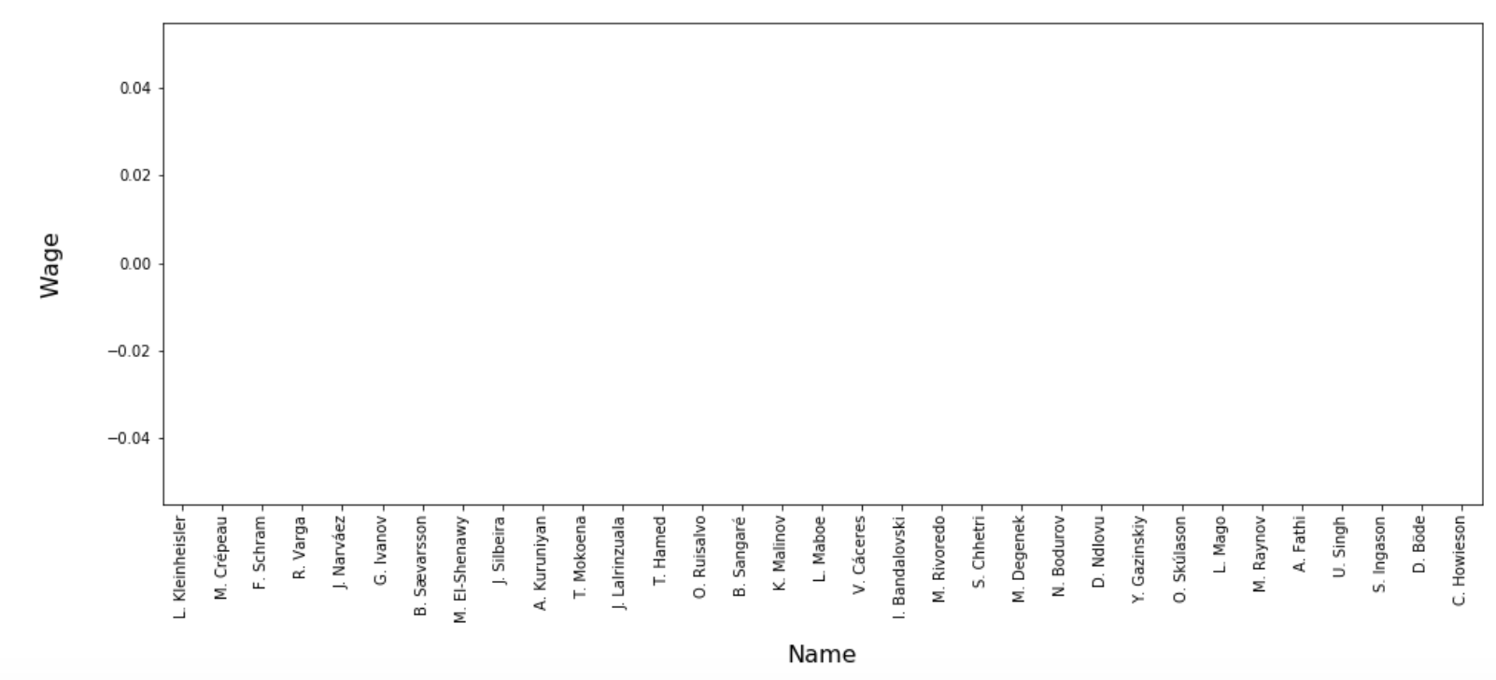
Transformation & Data Cleaning
Data Preparation
Finding Null Values & NAN(Not a Number)
Linear Regression
Logistic Regression
Step-wise Regression
Model Improvement

Slide 17
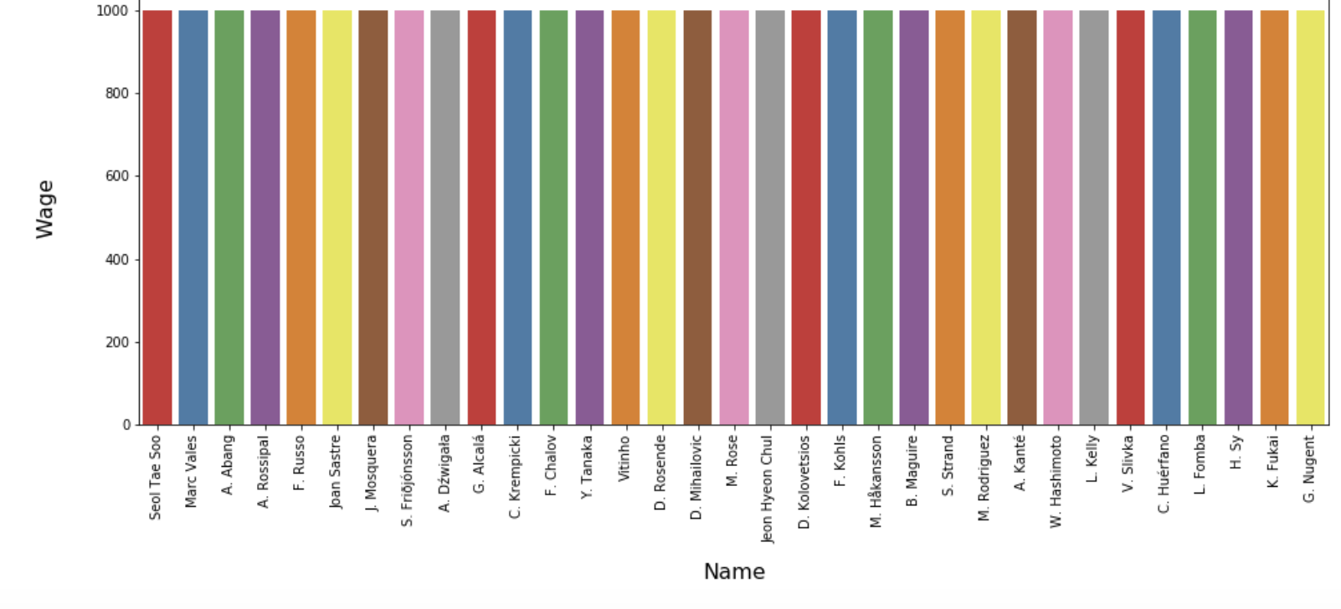
Transformation & Data Cleaning
Data Preparation
Replacing the zero values with median values
Linear Regression
Logistic Regression
Step-wise Regression
Model Improvement

Slide 18
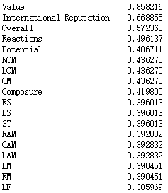
Data Preparation
After we clean up the dataset, we can start to choose the features of the model. we first investigate the high correlated value with target variable.
wage_corr_seq=(df.corr()['Wage']).sort_values(ascending=False).drop('Wage')
Linear Regression
Logistic Regression
Step-wise Regression
Model Improvement

Slide 19
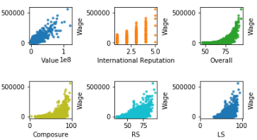
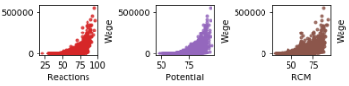
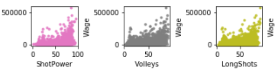
Data Preparation
fig, axes = plt.subplots(nrows=9, ncols=8, figsize=(10,10))
plt.subplots_adjust(left = -0.5, bottom=-0.5, hspace=1.0, wspace=1.0)
corr_to_wage = pd.Series()
for col in df.columns.values[1:]:
if ((col!='Wage') & (col!='Name')):
corr_to_wage[col] = df['Wage'].corr(df[col])
abs_corr_to_wage = corr_to_wage.abs().sort_values(ascending=False)
corr_to_wage = corr_to_wage.loc[abs_corr_to_wage.index]
for i in range(9):
for j in range(8):
sns.regplot(x=corr_to_wage.index.values[i*8+j], y='Wage', data=df,
ax=axes[i,j], fit_reg=False, marker='.')
axes[1,2].set_xlim(0,102)
plt.show()
Linear Regression
Logistic Regression
Step-wise Regression
Model Improvement

Slide 20

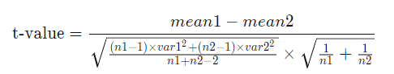
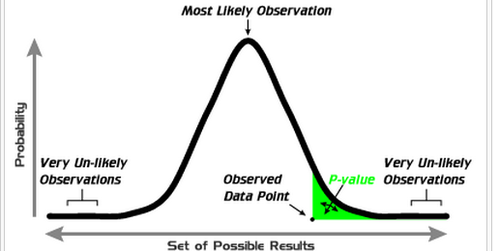
In order to research whether the features are significant. We use t-test for calculating p value for this task.
Data Preparation
What’s t-test?
What’s p-value?
Linear Regression
the p-value is the probability that, when the null hypothesis is true, the absolute value of the sample mean difference between two compared groups would be greater than or equal to the actual observed results
A t-test is a type of inferential statistic used to determine if there is a significant difference between the means of two groups
Logistic Regression
Step-wise Regression
Model Improvement

Slide 21
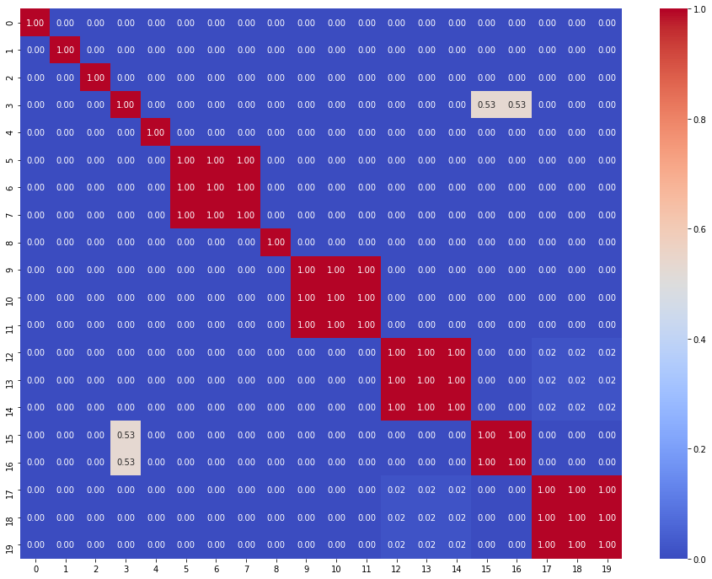
Data Preparation
allFeatures = df[abs_corr_to_wage.index[:20]].columns
matrix = [[0 for x in range(len(allFeatures))] for y in range(len(allFeatures))]
for i in range(len(allFeatures)):
for j in range(len(allFeatures)):
t, p = stats.ttest_ind(df[allFeatures[i]], df[allFeatures[j]])
matrix[i][j] = p
sign = pd.DataFrame(data=matrix)
plt.figure(figsize=(16,12))
sns.heatmap(data=sign,annot=True,fmt='.2f',cmap='coolwarm')
plt.show()
Linear Regression
Logistic Regression
Step-wise Regression
Model Improvement

Slide 22
Result
Data Preparation
Linear Regression
Based on the results of correlation with wage and the p value between features, we finally choose the following features:
'Value’, 'International Reputation’, 'Overall’, 'Reactions’, 'Potential’, 'RCM’, 'Composure’, 'RS'
Logistic Regression
Step-wise Regression
Model Improvement

Slide 23
Data Preparation
Linear Regression
Linear Regression
Logistic Regression
Step-wise Regression
Model Improvement

Slide 24
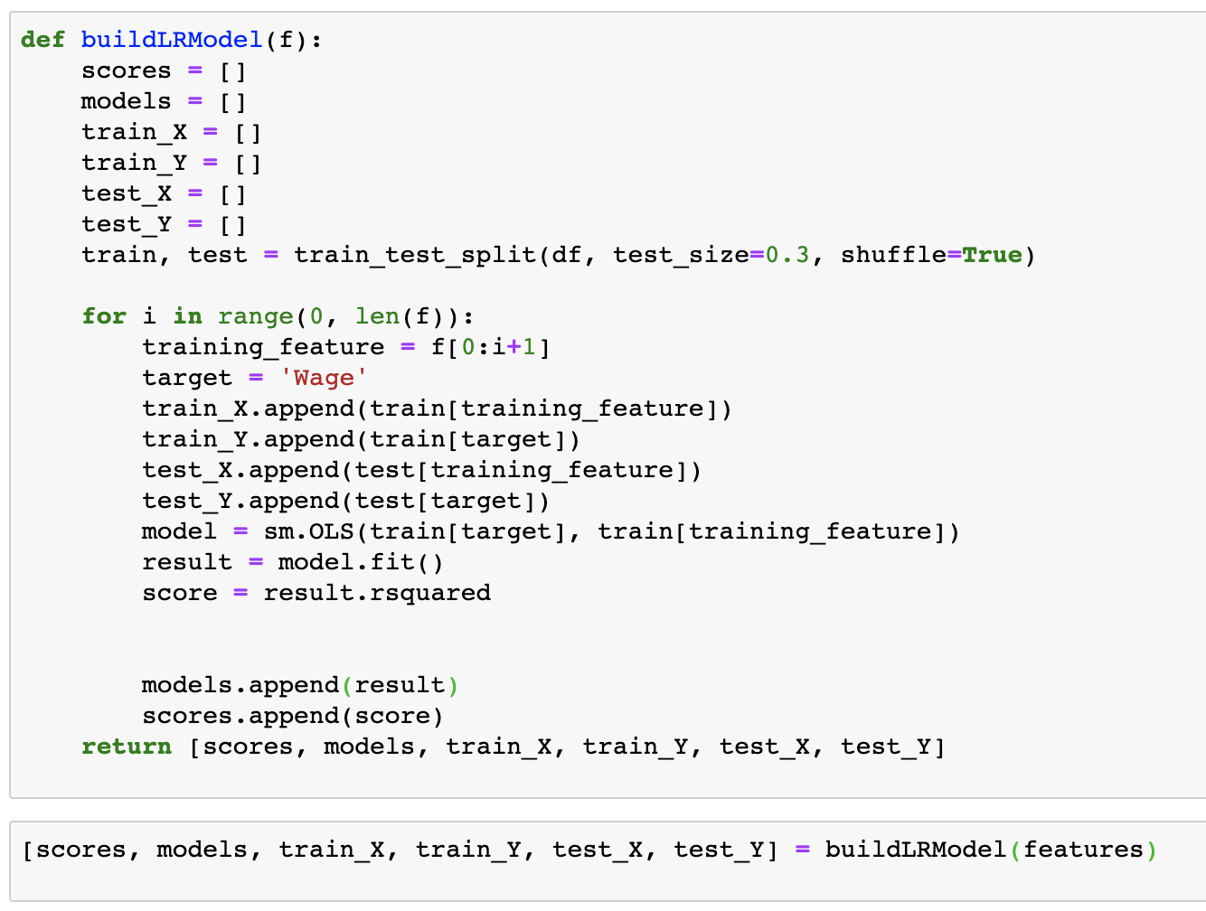
Define The Model
Data Preparation
Linear Regression
With the for loop, we put all the features into the model.
Use train_test_split to separate the data set, with test set size as 30%.
Get the model with sm.OLS function which is Ordinary Least Square.
Logistic Regression
Step-wise Regression
Model Improvement

Slide 25
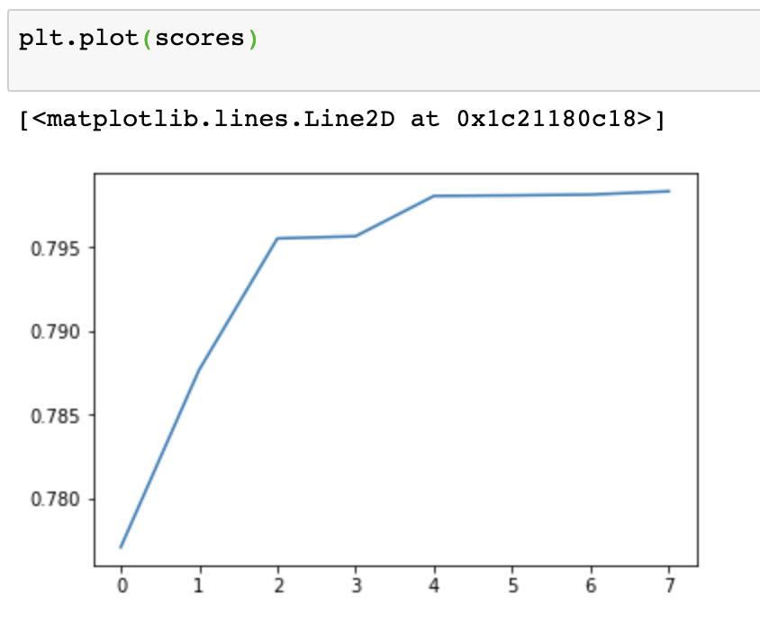
Plot The Score With Different Feature
Data Preparation
Linear Regression
Logistic Regression
Step-wise Regression
Model Improvement

Slide 26
Feature Result With Score
Data Preparation
Linear Regression
Best
Logistic Regression
Step-wise Regression
Composure
& RS
Potential &
RCM
Overall &
Reactions
International
Reputation
Model Improvement
Value

Slide 27
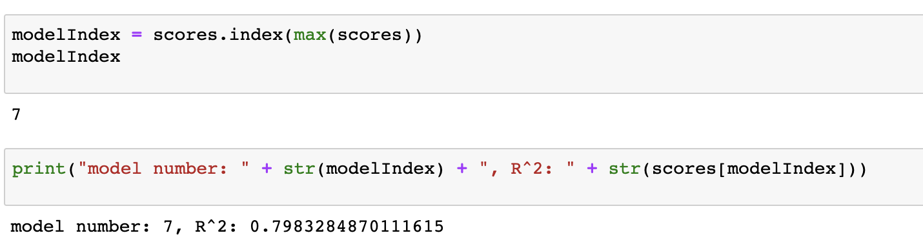
Select The Best Model
Data Preparation
Linear Regression
Logistic Regression
Step-wise Regression
Model Improvement

Slide 28
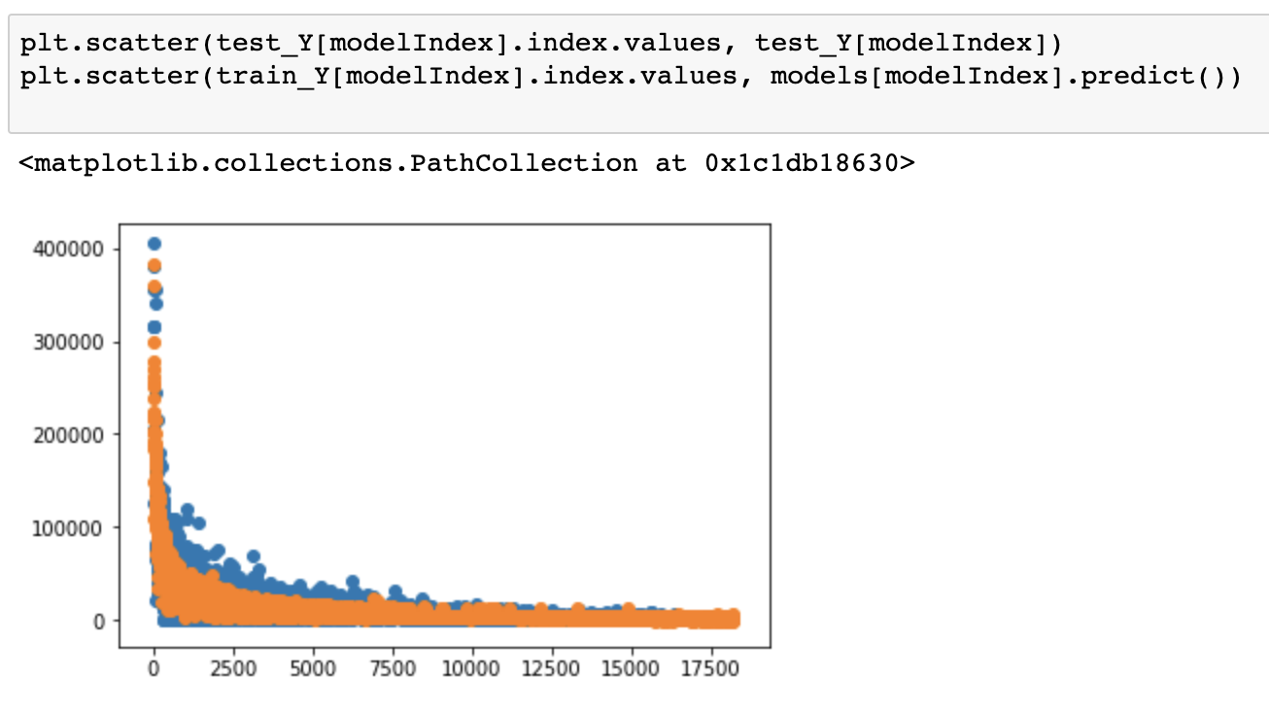
Plot The Predict Value With Test Set
Data Preparation
Linear Regression
Logistic Regression
Step-wise Regression
Model Improvement

Slide 29
Why Cross Validation？
Simply separate the dataset to train set and the test set.
Data Preparation
Separate the dataset for 5 parts, and use each part to predict the model.
Linear Regression
Normal
Cross
Validation
Logistic Regression
Step-wise Regression
Cross Validation
Model Improvement

Slide 30
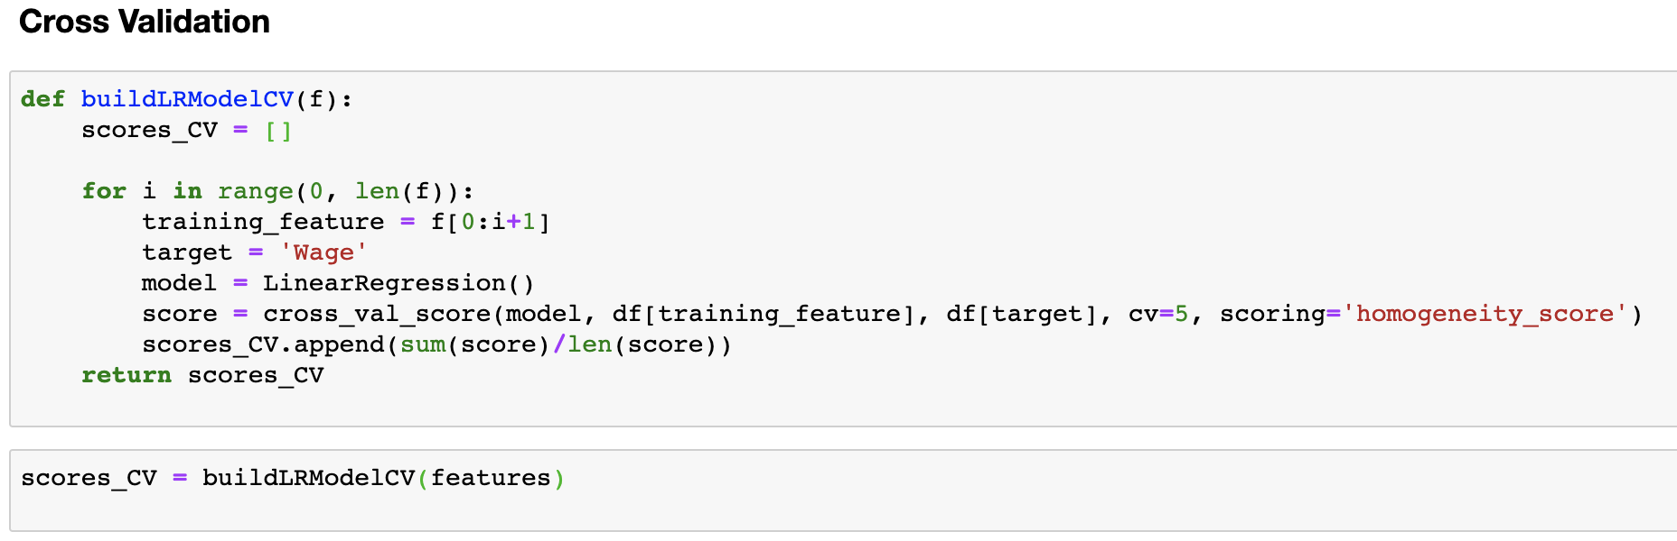
Cross Validation
Data Preparation
Linear Regression
Logistic Regression
Step-wise Regression
Model Improvement

Slide 31
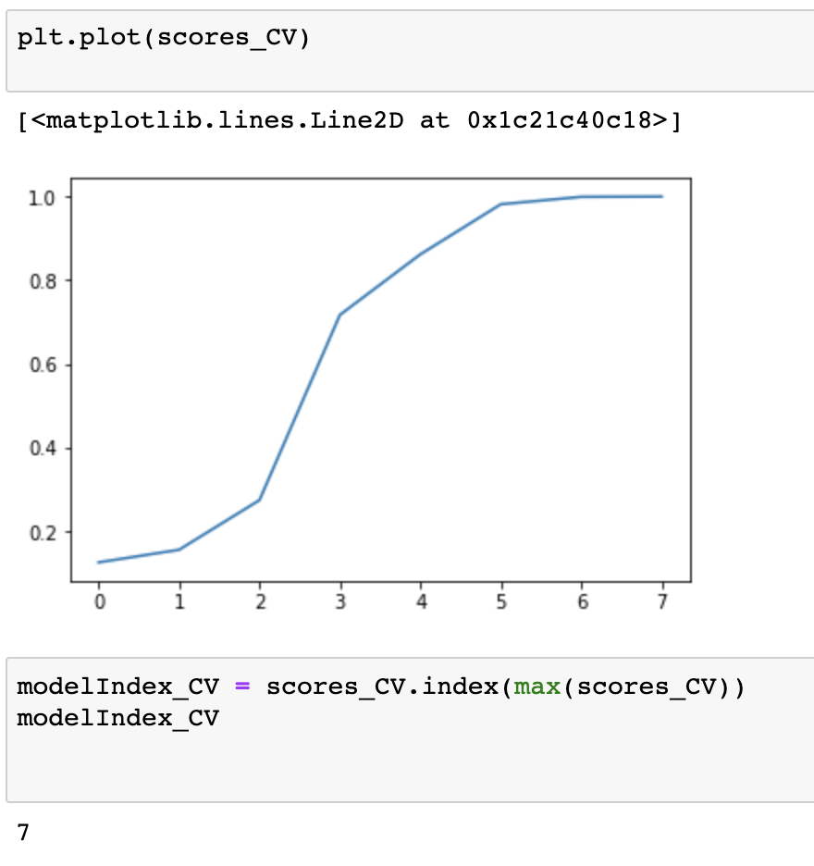
Plot The Score With Different Feature
Data Preparation
Linear Regression
Logistic Regression
Step-wise Regression
Model Improvement

Slide 32
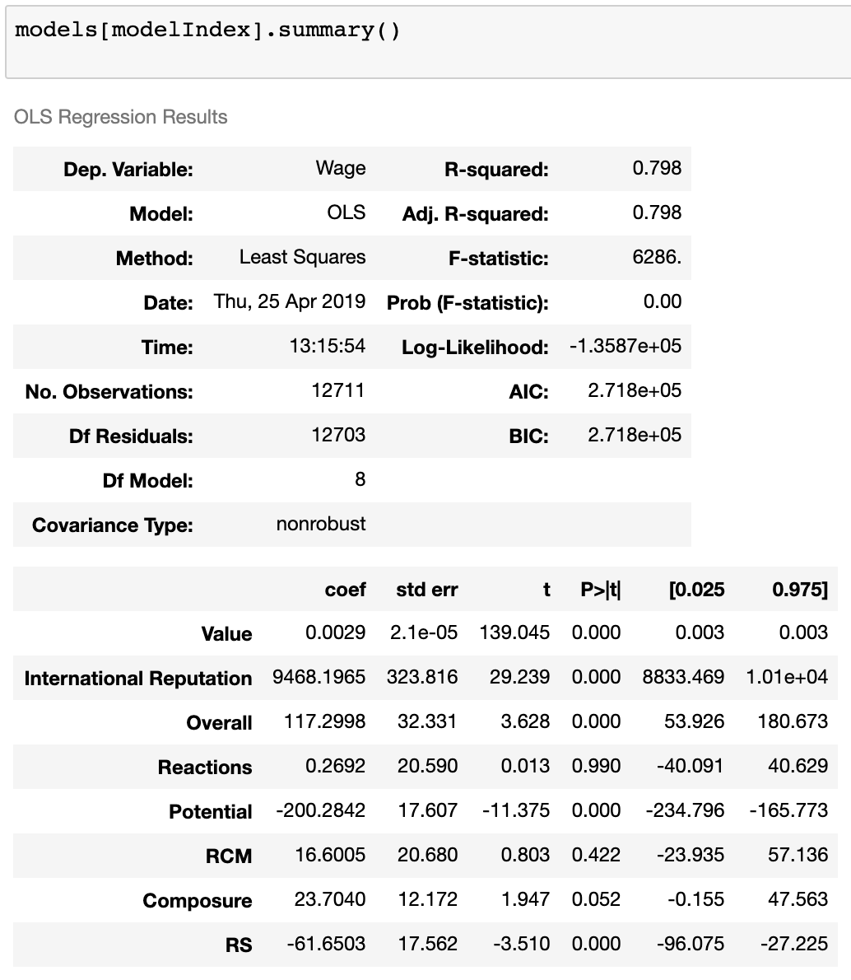
Model Summary
Data Preparation
Linear Regression
Logistic Regression
Step-wise Regression
Model Improvement

Slide 33
AIC & BIC
Data Preparation
Linear Regression
AIC
BIC
Logistic Regression
Step-wise Regression
Model Improvement
AIC is a standard for measuring the goodness of statistical model fitting. It can weigh the complexity of the estimated model and the superiority of the model fitting data.
BIC uses subjective probability estimation for partially unknown states under incomplete intelligence, and then corrects the probability of occurrence with Bayesian formula.

Slide 34
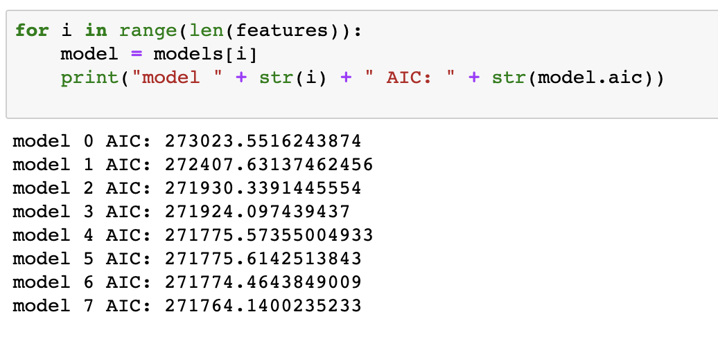
AIC For Each Model
Data Preparation
Linear Regression
Logistic Regression
Step-wise Regression
Model Improvement

Slide 35
Data Preparation
Linear Regression
Logistic Regression
Logistic Regression
Step-wise Regression
Model Improvement

Slide 36
Logistic model
Data Preparation
1
widely used statistical model
Linear Regression
2
Binary dependent variable
Logistic Regression
3
discrete outcome
Step-wise Regression
Model Improvement

Slide 37
LOGO
Advantages
Data Preparation
Easy to implement
Be applicable on complex Algorithms
Linear Regression
very efficient to train
Logistic Regression
it can be implemented relatively easy and quick
Efficient
Ignore irrelevant data
Step-wise Regression
not require too many computational resources
logistic regression does work better
Model Improvement

Slide 38
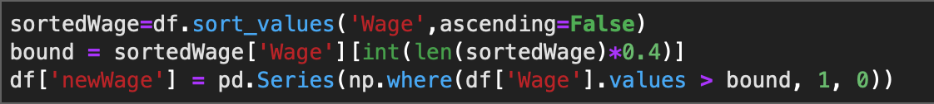
introduction
LOGO
Define binary data
.
Data Preparation
Linear Regression
Logistic Regression
Top 40% of all → 1
Remaining 60% →0
Step-wise Regression
Model Improvement

Slide 39
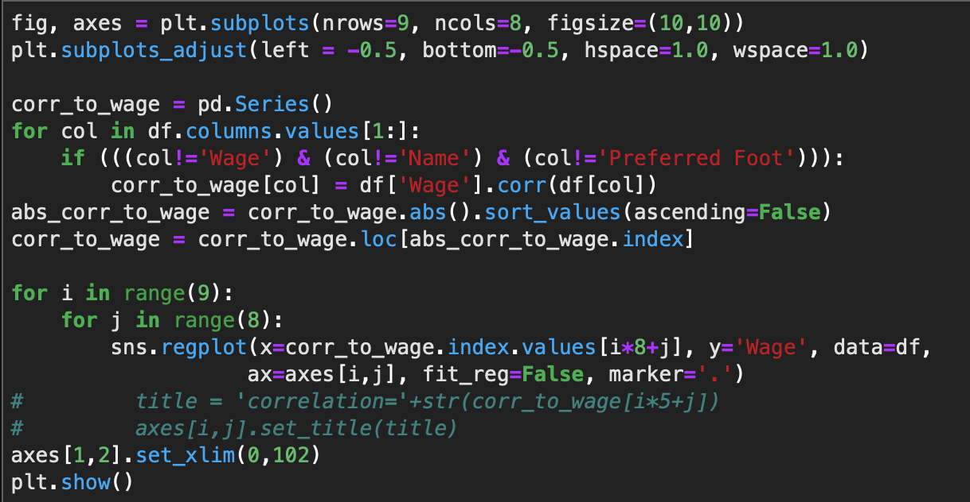
introduction
Choose features
.
Data Preparation
Linear Regression
Logistic Regression
Choose top 20 features that have high correction with wage
Step-wise Regression
Model Improvement

Slide 40
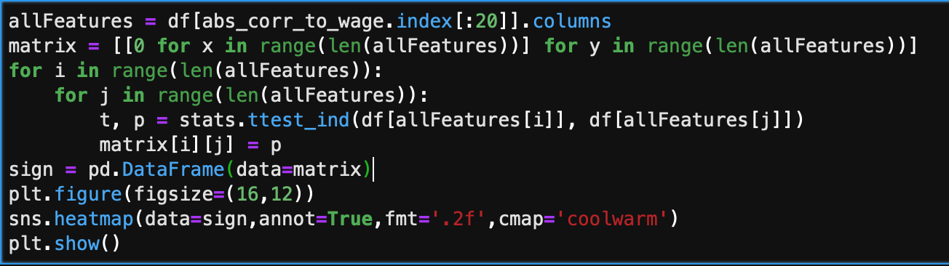
introduction
LOGO
Choose features
.
Data Preparation
Linear Regression
Logistic Regression
Step-wise Regression
Choose 8 features that have low significant
Model Improvement

Slide 41
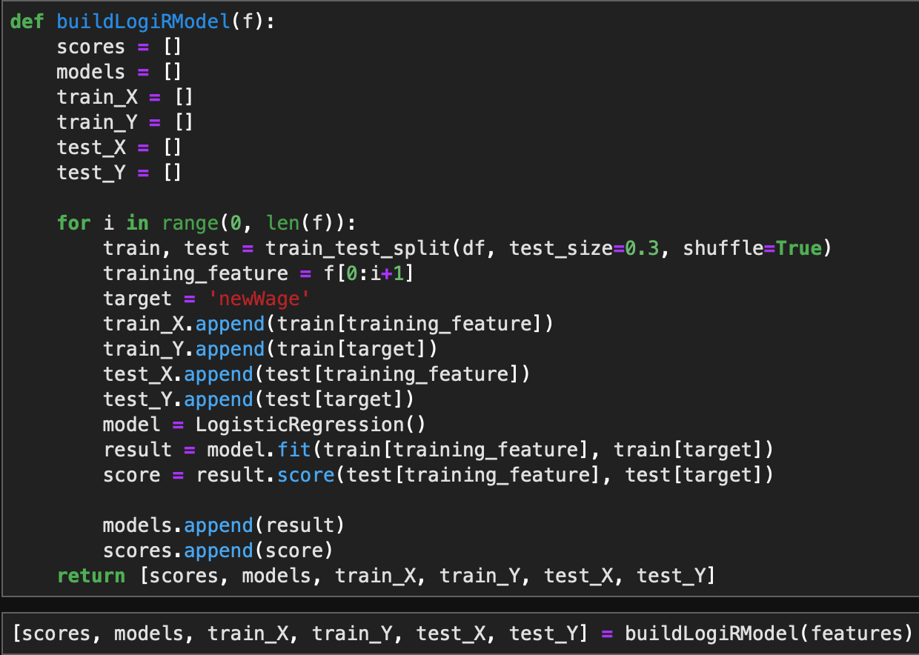
introduction
LOGO
Build logical model
.
Data Preparation
Linear Regression
Test_size → 30%
choose 30% of players to test this model
Logistic Regression
result→ train a new model
Step-wise Regression
score→ accuracy mean
Model Improvement

Slide 42
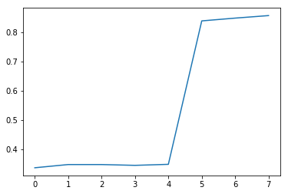
introduction
LOGO
plot
.
Data Preparation
Linear Regression
The most accuracy of the model is about 0.8577.
We can obtain the model 7 (8 features) is the most accuracy to testing data.
Logistic Regression
Step-wise Regression
Model Improvement

Slide 43
Cross Validation
Data Preparation
1
partition the original sample
Linear Regression
2
one subsample to test model
Logistic Regression
3
k results can then be averaged
Step-wise Regression
Model Improvement

Slide 44
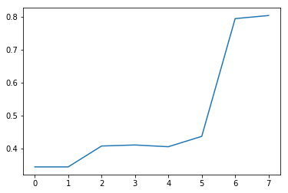
introduction
Cross Validation
Data Preparation
Linear Regression
The mean accuracy are lightly less than one we calculated previously, but overall, the model seven still stand out.
We can still obtain the model 7 (8 features) is the most accuracy to testing data.
Logistic Regression
Step-wise Regression
Model Improvement

Slide 45
Data Preparation
Linear Regression
Step-wise regression
Logistic Regression
Step-wise Regression
Model Improvement

Slide 46
Multicollinearity refers to the fact that the model estimates are distorted or difficult to estimate accurately due to the existence of exact correlations or high correlations between explanatory variables in linear regression models.In general, due to the limitations of economic data, the model is not properly designed, resulting in a general correlation between explanatory variables in the design matrix. The case of complete collinearity is rare, and there is generally a degree of collinearity, that is, approximate collinearity.
The Variance Inflation Factor (VIF) is a measure of colinearity among predictor variables within a multiple regression. It is calculated by taking the the ratio of the variance of all a given model's betas divide by the variane of a single beta if it were fit alone.
Data Preparation
Linear Regression
Logistic Regression
Step-wise Regression
Model Improvement

Slide 47
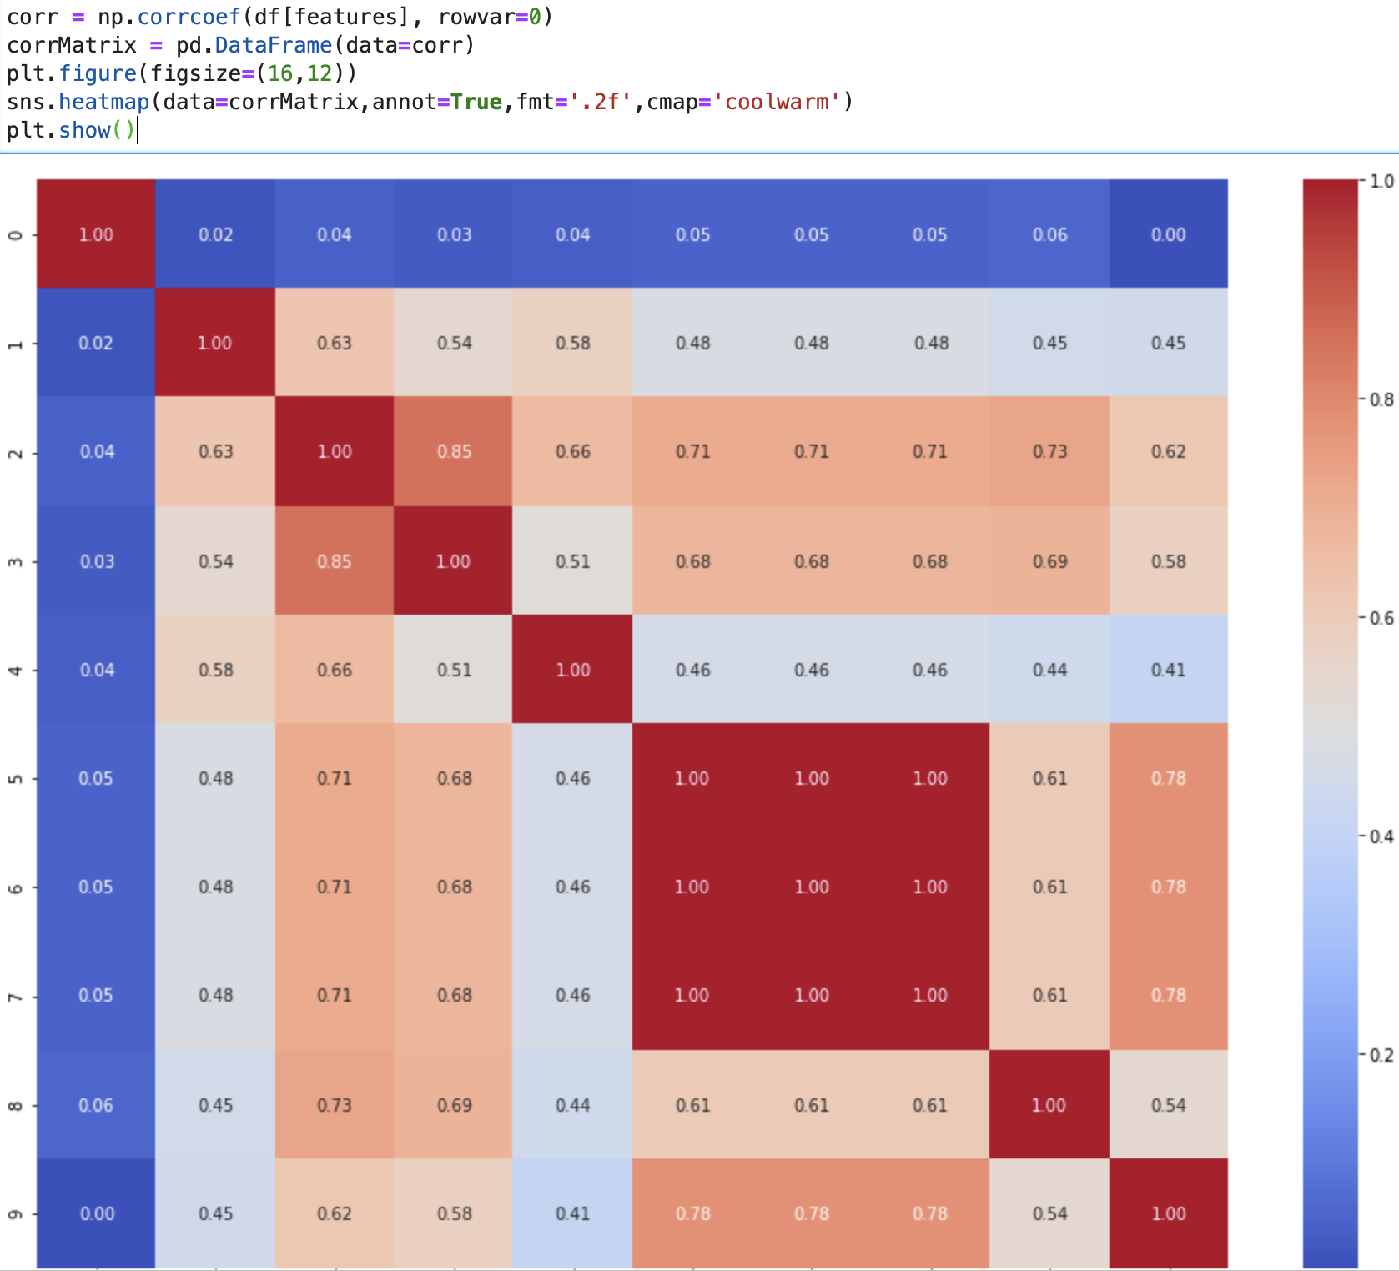
Data Preparation
Linear Regression
Logistic Regression
Step-wise Regression
Model Improvement

Slide 48
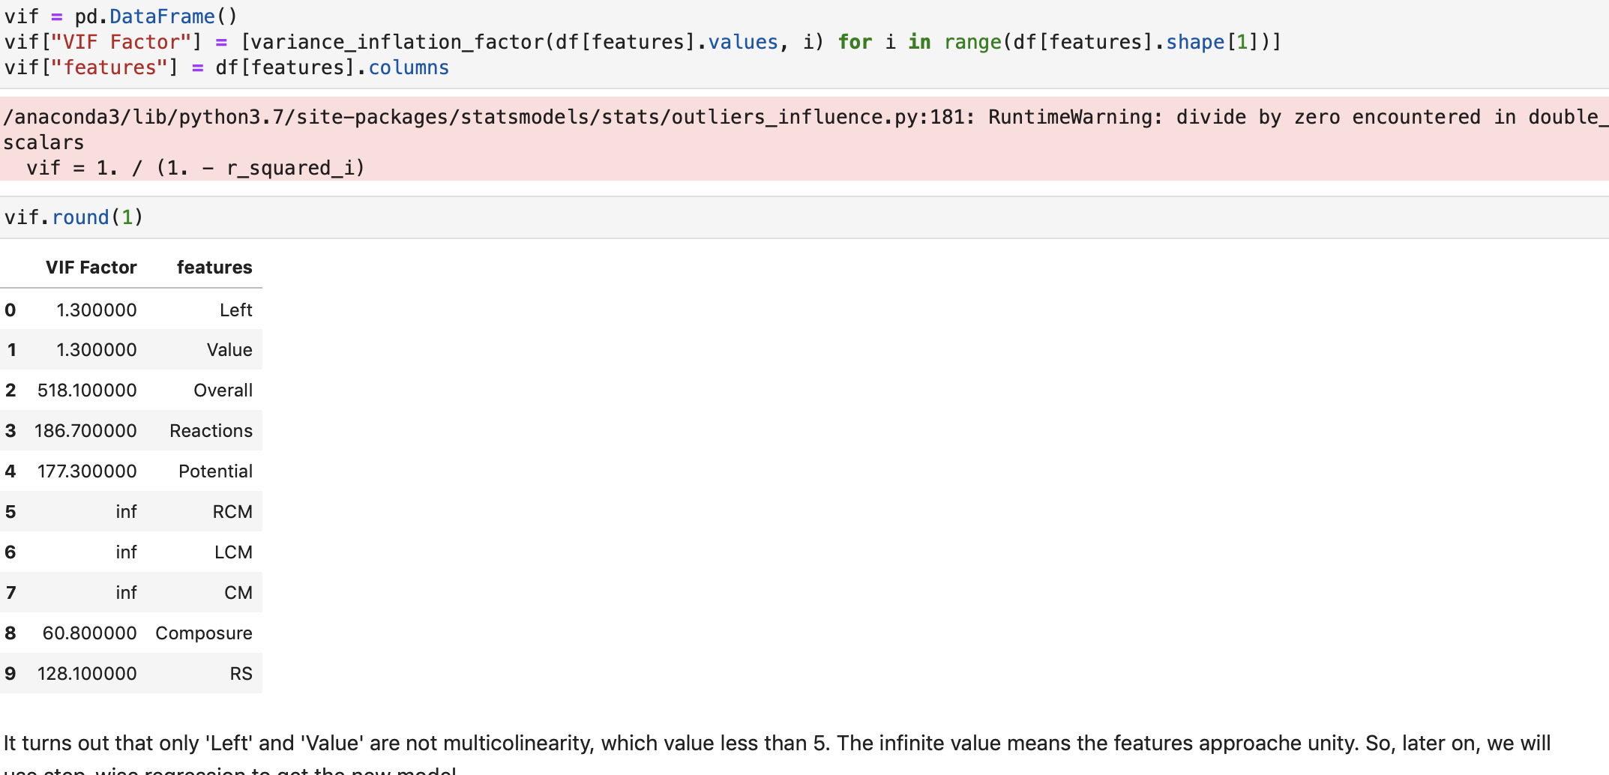
Data Preparation
Linear Regression
Logistic Regression
Step-wise Regression
Model Improvement

Slide 49
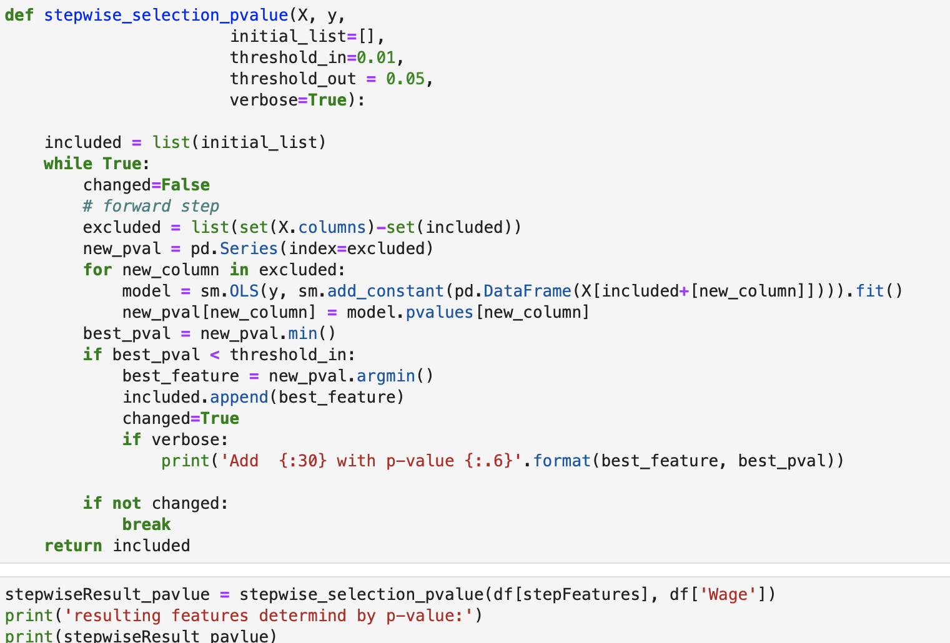
Data Preparation
Linear Regression
Logistic Regression
Step-wise Regression
Model Improvement

Slide 50
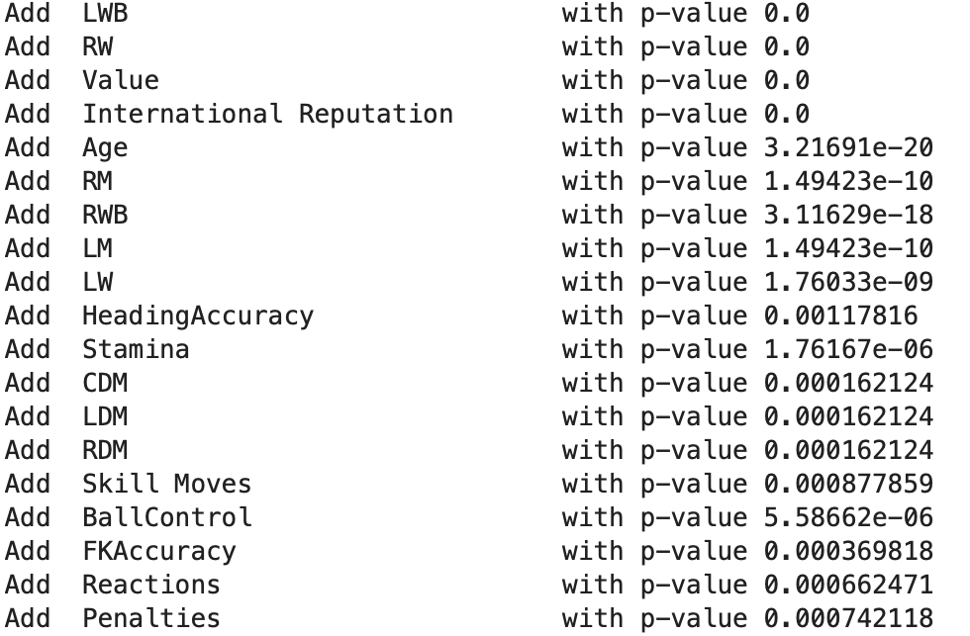
Data Preparation
Linear Regression
Logistic Regression
Step-wise Regression
Model Improvement

Slide 51
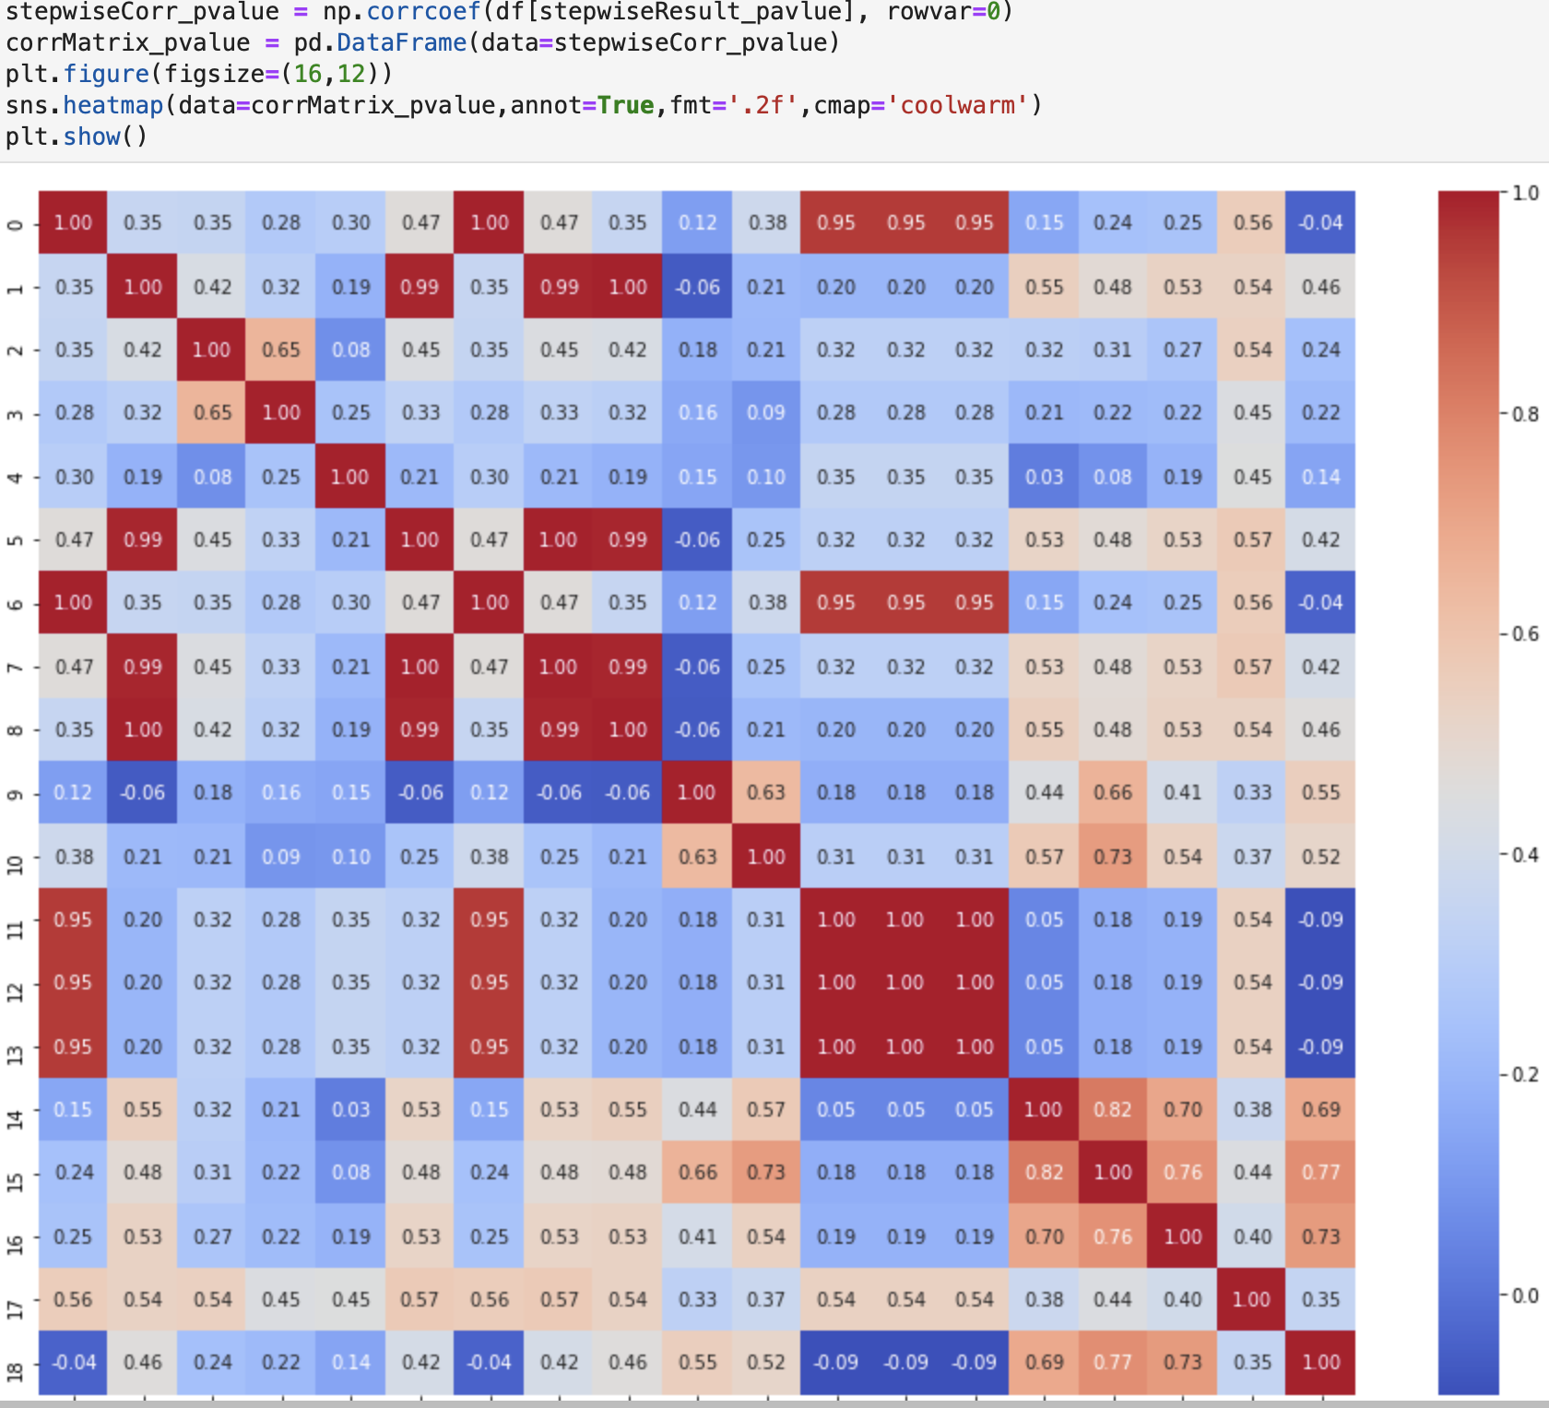
Data Preparation
Linear Regression
Logistic Regression
Step-wise Regression
Model Improvement

Slide 52
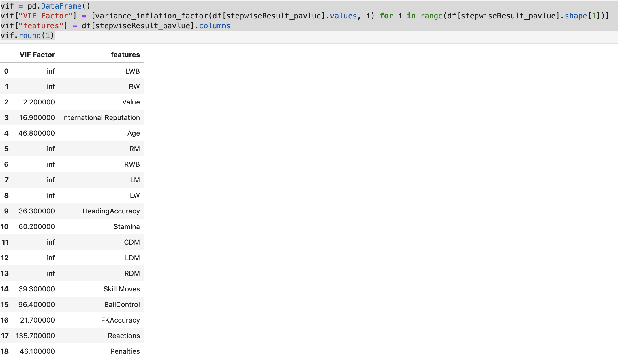
Data Preparation
Linear Regression
Logistic Regression
Step-wise Regression
Model Improvement

Slide 53
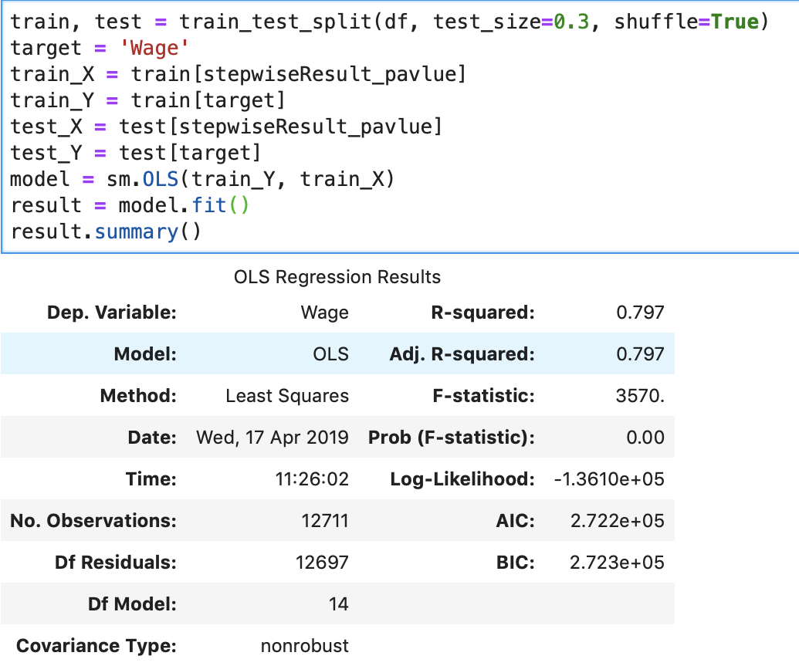
Data Preparation
Linear Regression
Logistic Regression
Step-wise Regression
Model Improvement

Slide 54
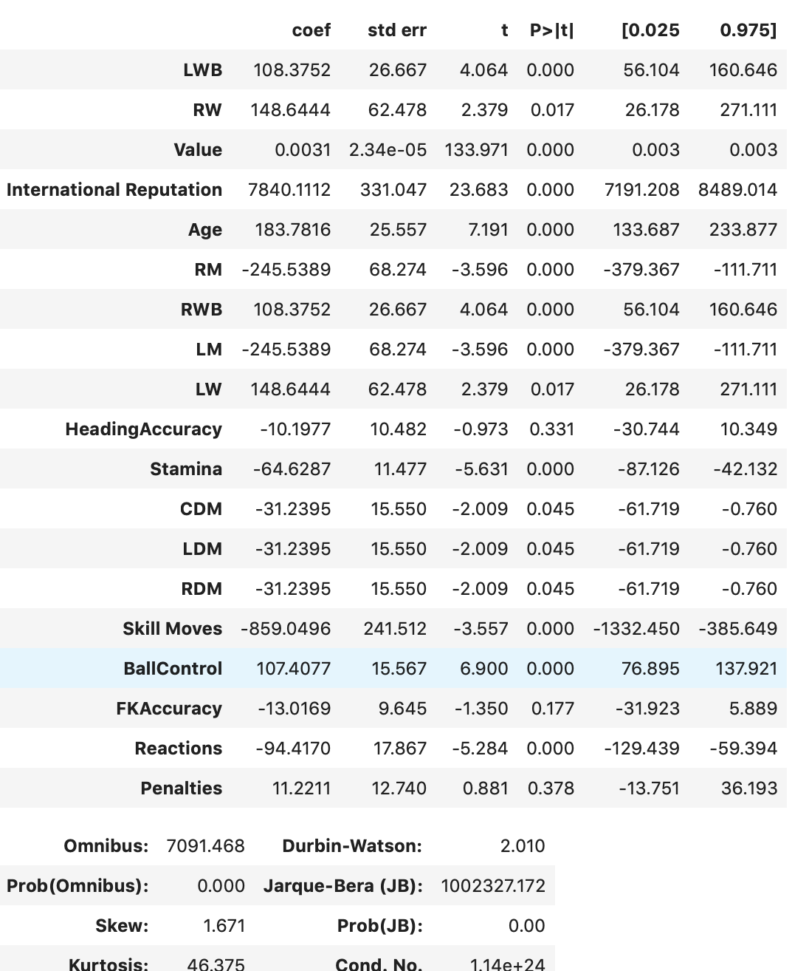
Data Preparation
Linear Regression
Logistic Regression
Step-wise Regression
Model Improvement

Slide 55
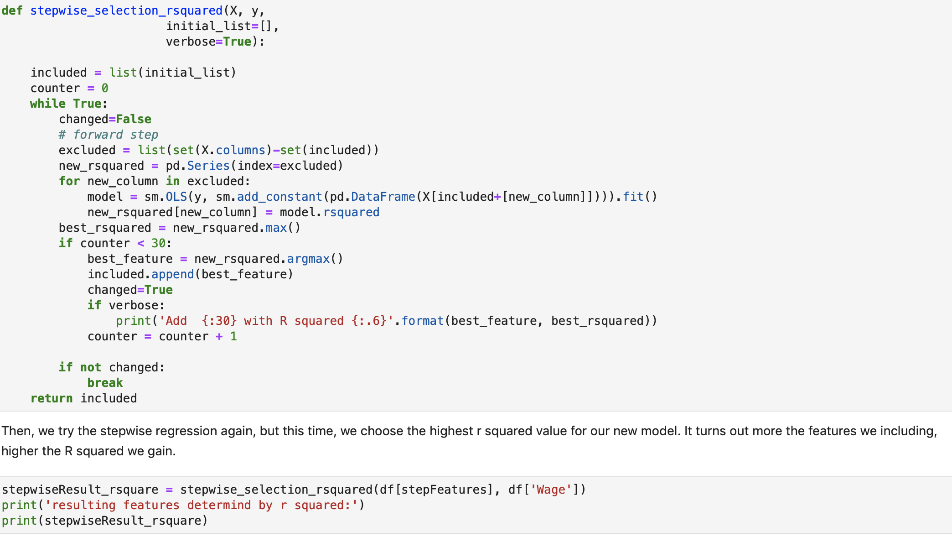
Data Preparation
Linear Regression
Logistic Regression
Step-wise Regression
Model Improvement

Slide 56
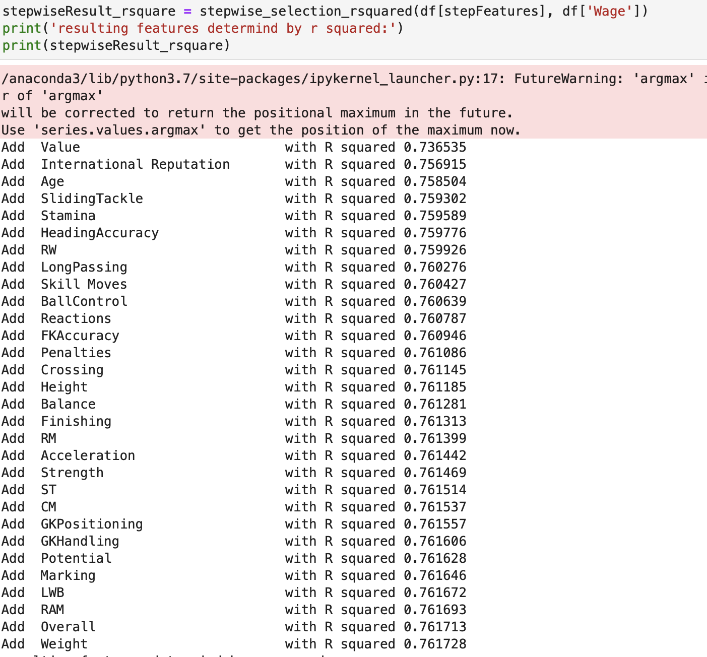
Data Preparation
Linear Regression
Logistic Regression
Step-wise Regression
Model Improvement

Slide 57
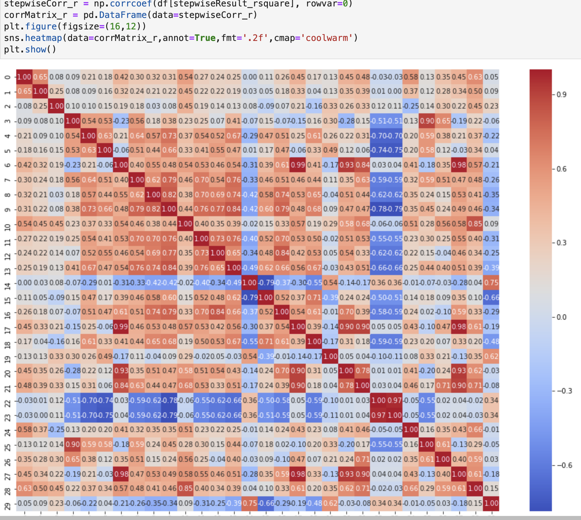
Data Preparation
Linear Regression
Logistic Regression
Step-wise Regression
Model Improvement

Slide 58
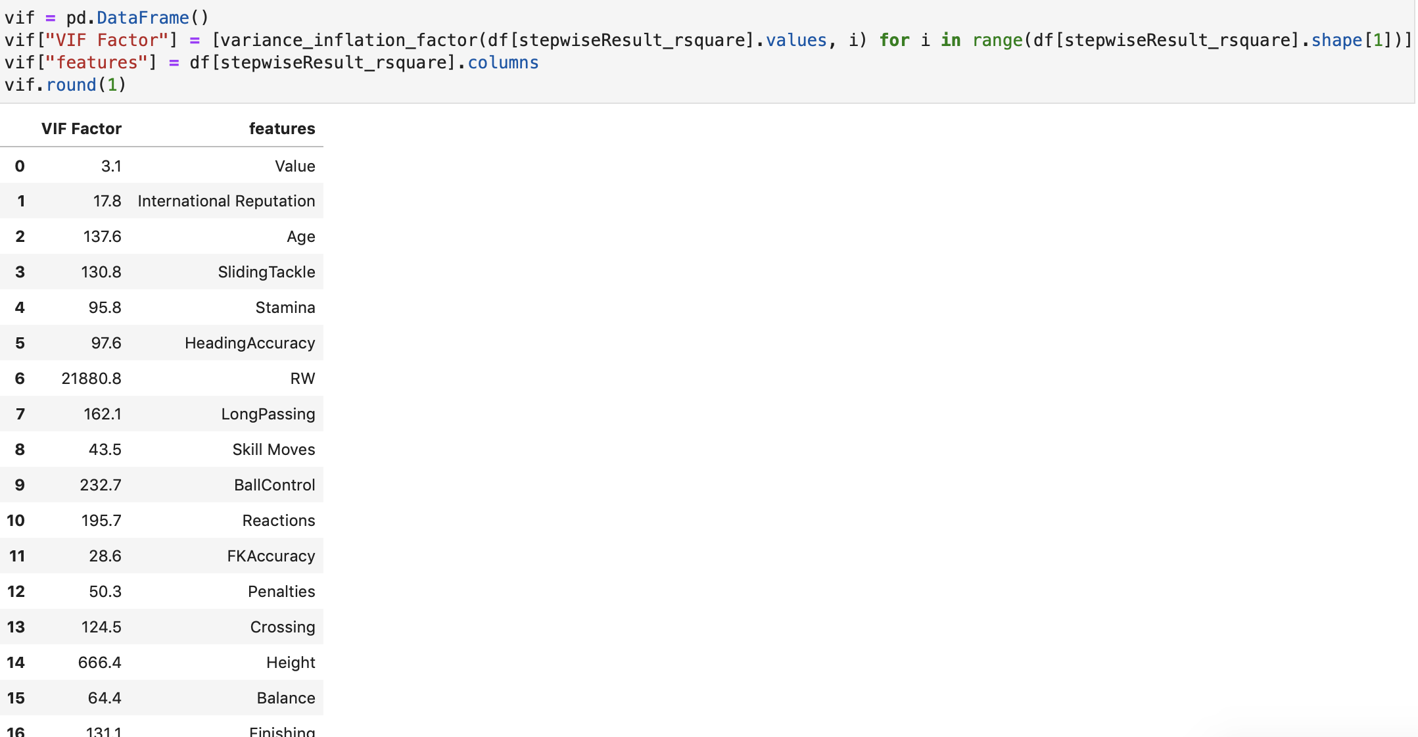
Data Preparation
Linear Regression
Logistic Regression
Step-wise Regression
Model Improvement

Slide 59
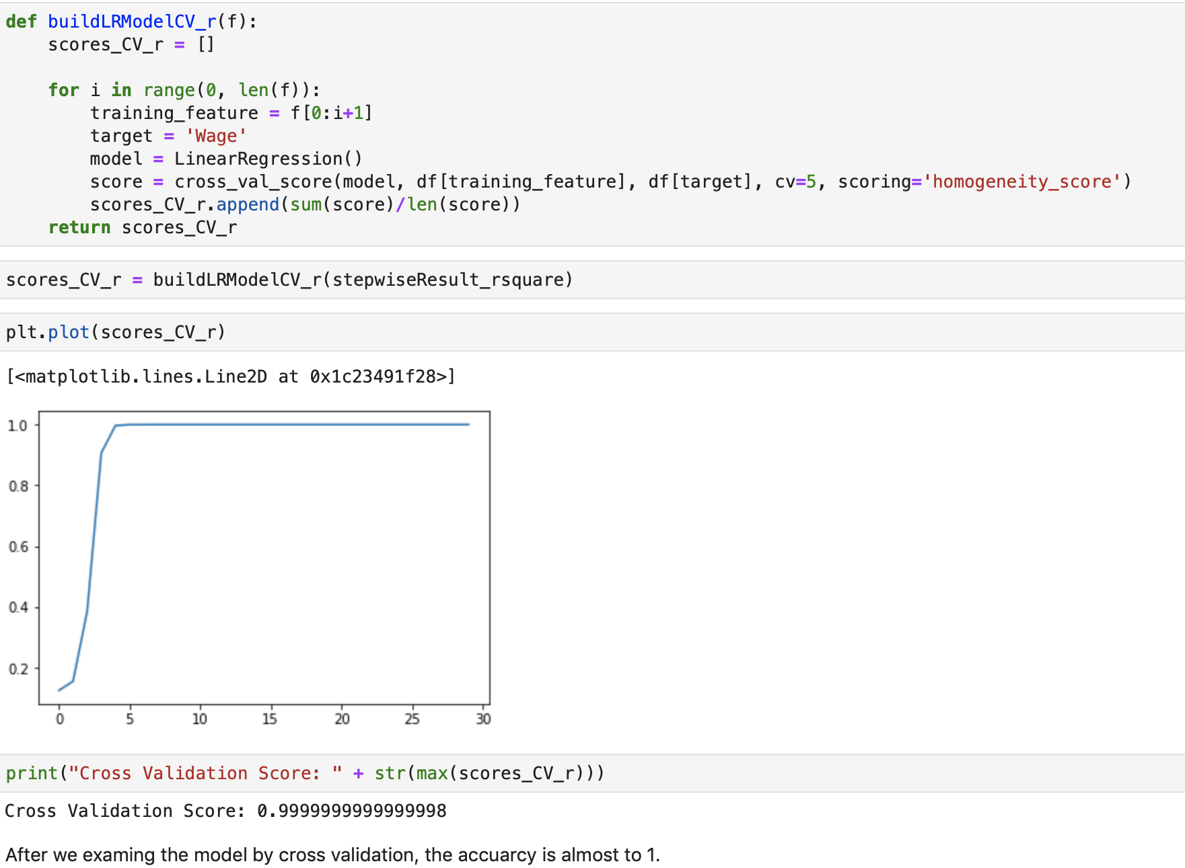
Data Preparation
Linear Regression
Logistic Regression
Step-wise Regression
Model Improvement

Slide 60
Interaction effects
Data Preparation
In statistics, an interaction may arise when considering the relationship among three or more variables
Linear Regression
describes a situation in which the effect of one causal variable on an outcome depends on the state of a second causal variable

Logistic Regression
Although commonly thought of in terms of causal relationships, the concept of an interaction can also describe non-causal associations.
Step-wise Regression
Interactions are often considered in the context of regression analyses or factorial experiments.
Model Improvement

Slide 61
Data Preparation
Linear Regression
01
02
03
04
Logistic Regression
Use the parameter we select from Pvalue
Split the data into train and test parts
Remove whitespace from df, then, use stepwise function to get result
Find is there has relation between two feature
Step-wise Regression
Model Improvement

Slide 62
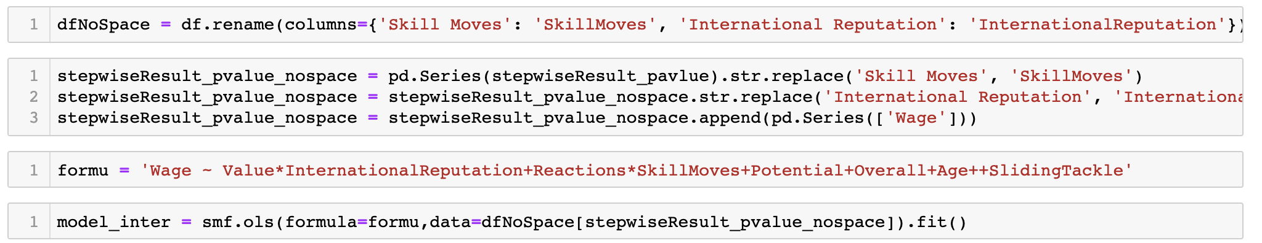
Data Preparation
Linear Regression
Logistic Regression
Step-wise Regression
Here is how we achieve the Interaction, we need try every two features we guess are interacted, till we find some interaction between some features.
Model Improvement

Slide 63
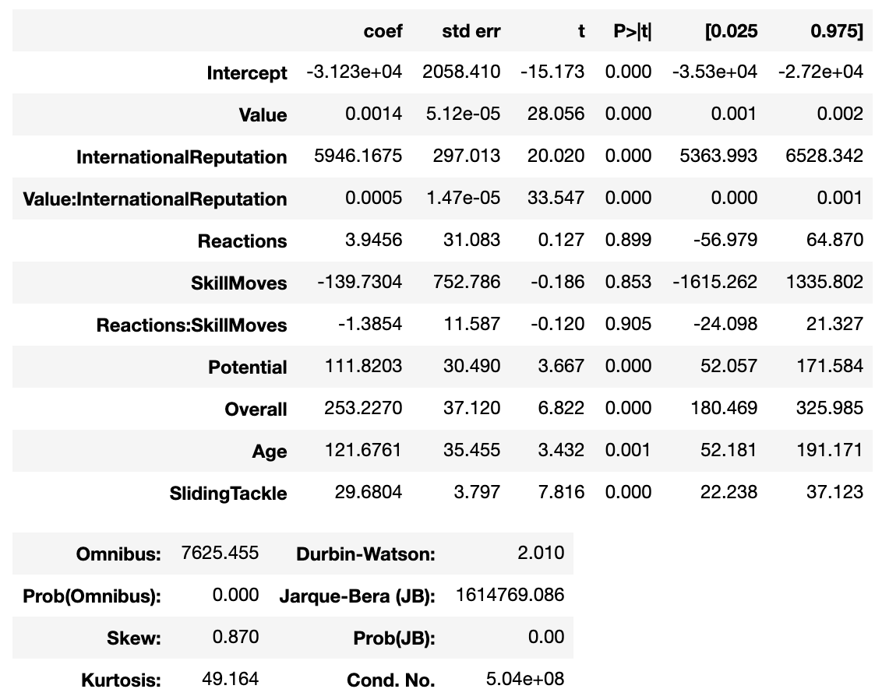
Data Preparation
Interaction
Linear Regression
Logistic Regression
Step-wise Regression
As the conclusion part, we found there has strong interaction effects at value feature with International Reputation feature and Skill Moves feature with Reactions feature. Also, it is better to use Regularization function by using Ridge model than using Interaction effects.
Model Improvement

Slide 64
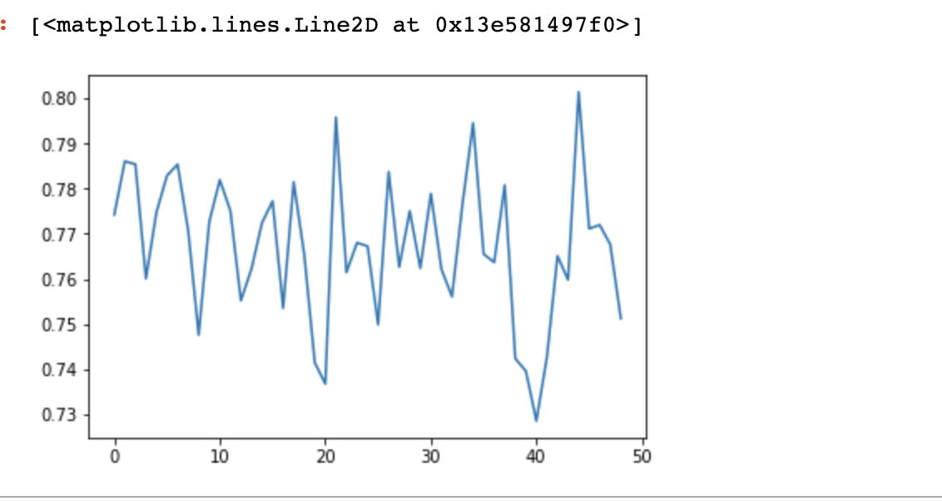
Regularization
Data Preparation
Linear Regression
In regularization part, we use regularization to undermine the overfitting problem by Ridge regression. We investigate different lambda and get the model with the highest R^2. As the result, it seems a little bit improve the original model (first stepwise regression).
Logistic Regression
Step-wise Regression
Model Improvement

Slide 65
Value
Age
Data Preparation
International Reputation
Sliding Tackle
Stamina
Heading Accuracy
Linear Regression
Logistic Regression
Step-wise Regression
Conclusion
With previous regression result, the FIFA player’s wage is most relevant to these features, Value, International Reputation, Age, Sliding Tackle, Stamina, Heading Accuracy and others.
Model Improvement

Slide 66
Data Preparation
Step-Wise
Linear
Logic
Linear Regression
Logistic Regression
R-Squared : 0.798
R-Squared : 0.8577
R-Squared : 0.999
Step-wise Regression
Conclusion
We used 3 different regression functions to get the model summary, and we can see, the step-wise regression feats best, which get an almost 1 R-Squared Score which is 0.99.
Model Improvement

Slide 67
THANK YOU Handan Liu
For Your Support And Learning!
Notes:
更多精品素材：http://shop248912786.taobao.com/index.htm （下拉可隐藏）

